Slide 1






Techno wizard
Team members
S R VIKNESH
YOGESWARI
VARSHAA
A JOHN SAMUEL
A JOEL HENDRY
K MERVEEN JACOB
Mentors
Dr.P Kaplavani PhD, Associate Professor
Department of Information Technology
Dr. Senthil Kumar PhD, Associate Professor
Department of Electronics and Communication Engineering

Slide 2
The Problem STATEMENT
What is the problem?
Who has this problem?
Ministry of Power
Why should this problem be solved?
Electric vehicles are viewed upon as an alternative transportation medium and therefore it is critical to enhance the sustainability and performance which requires monitoring.
Monitoring the battery life of Electric Vehicles.

Slide 3
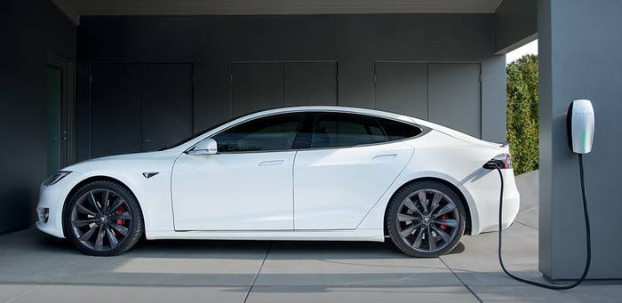
NO Of cycles
MONITORING
Battery percentage ,a point at which the battery is put on charger and the maximum point that has been charged is noted at each cycle of recharge. These data are updated in the database in cloud via wifi and the processed using algorithm which is proposed.

Slide 4
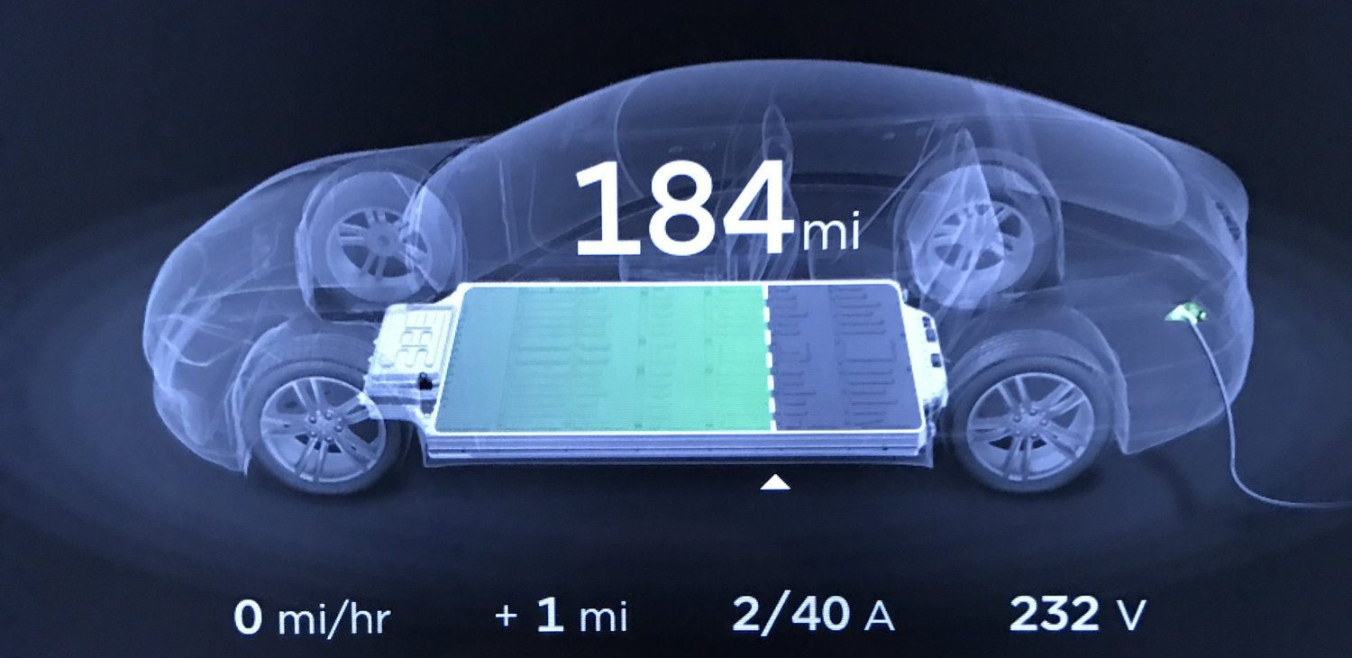
Distance To Empty
Distance to empty calculates the approximate distance you can drive with the amount of charge remaining in the battery. This calculation is based off of the average charge consumption over the past 20 miles of driving along with the amount of charge remaining in the battery.

Slide 5
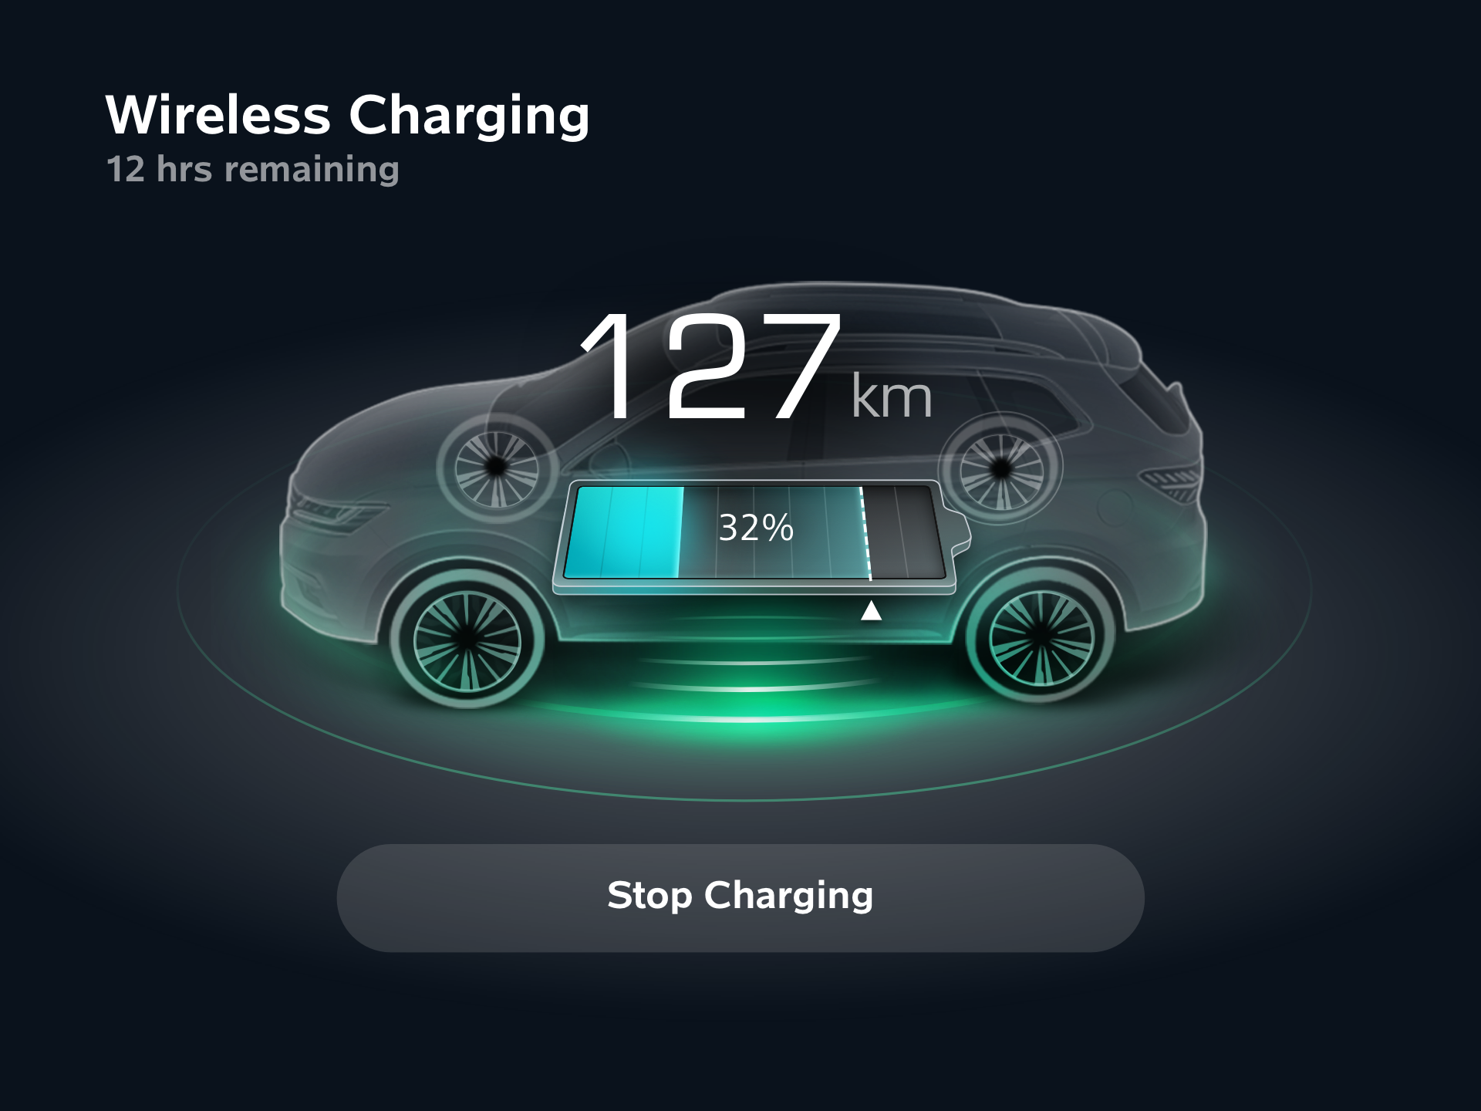
Charge Remaining:
There are various methods to calculate the remaining charge of the battery. Each and every method has
different approaches on the calculations.
Voltage Method
Hydrometer

Slide 6
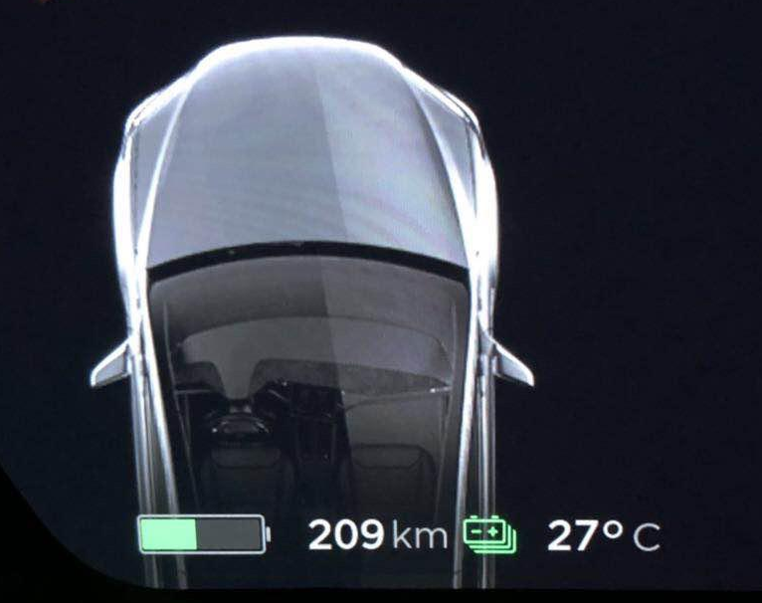
Temperature
we proposed a new noninvasive temperature measuring method based on magnetic nanoparticles for electric vehicle lithium-ion battery. At first, the mechanism of magnetic nanoparticles for battery temperature measurement was studied. Then, a temperature measuring model was established. Excitation and measurement system of AC magnetic field was built for temperature measuring experiments. The test results demonstrated that the proposed method could accurately measure the internal temperature of the battery.

Slide 7

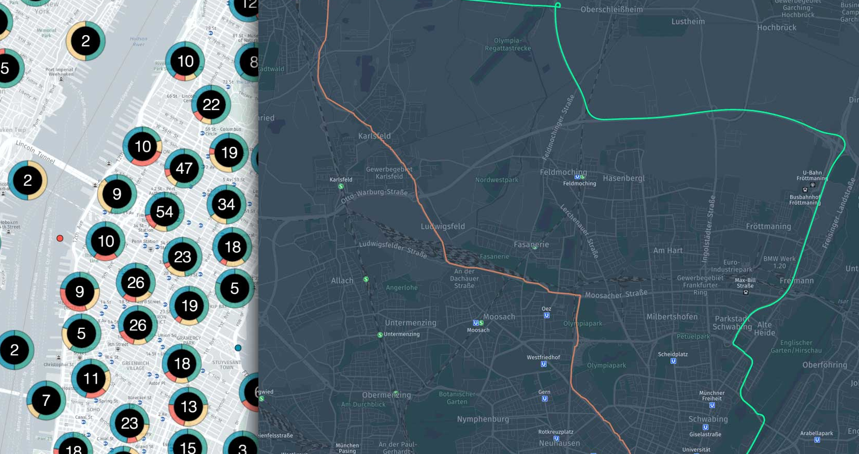
Location
The rented e-vehicles can be located using the gadget that has been installed in the vehicle. The GPS enabled gadget sends the exact location using the coordinates (Latitude, Longitude). It can also pin point the exact location using maps.

Slide 8
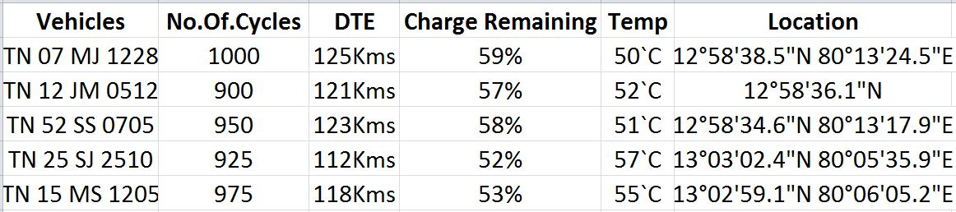
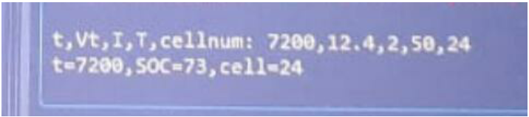
DATABASE
(Monitoring several vehicles)
(Monitoring several vehicles)
DATABASE
Output:

Slide 9
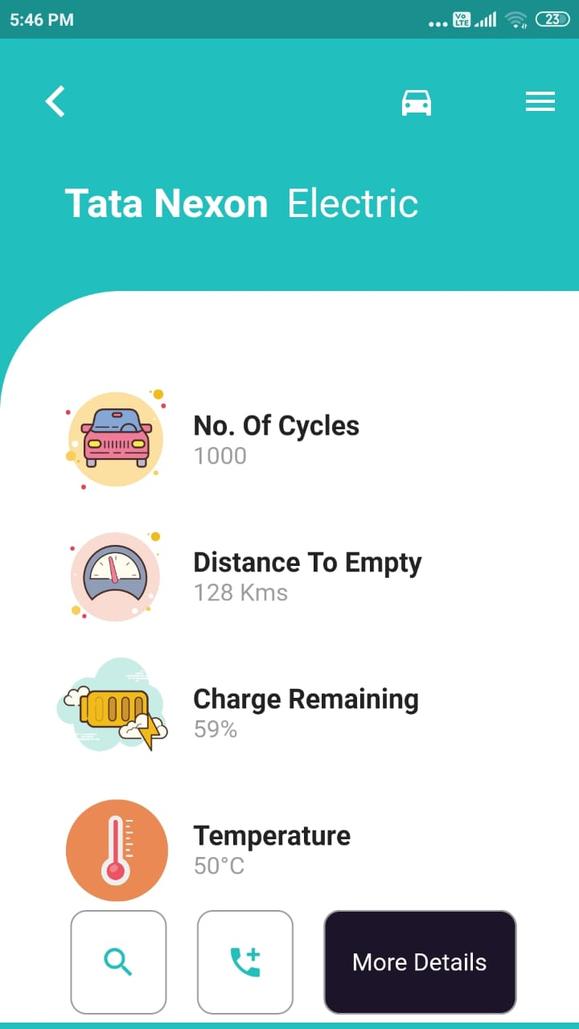
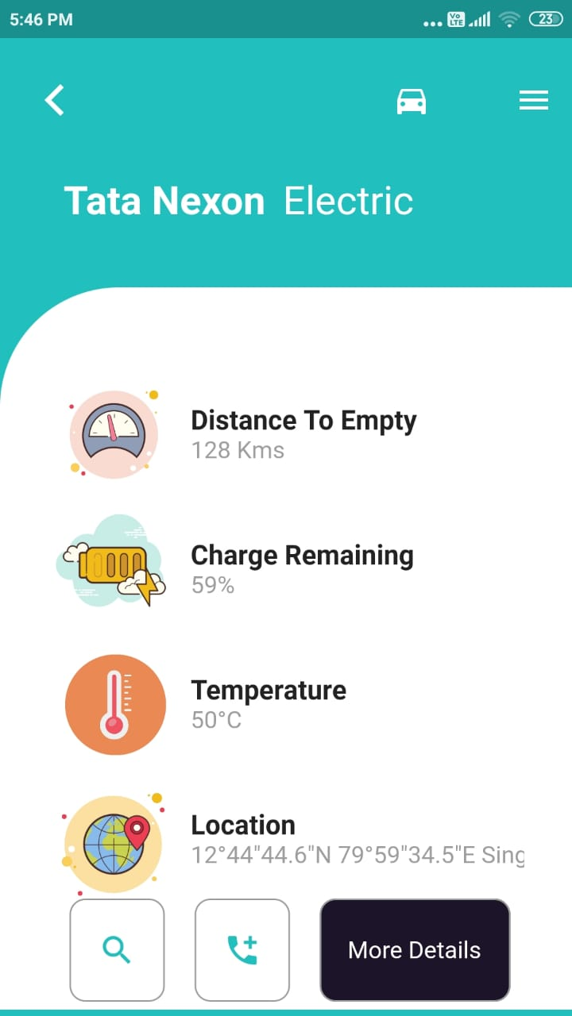
PERSONALIZED USER SCREEN

Slide 10
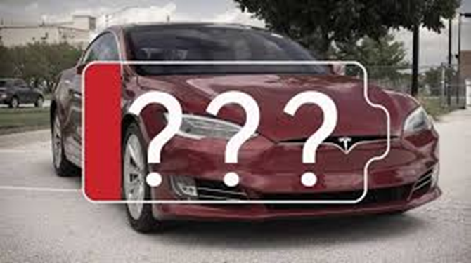
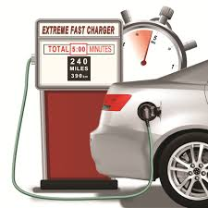

MAINTENANCE UNIT
HOW LONG THE BATTERY LAST??
WHAT WILL BE CONDITION OF BATTERY??
WHAT IS THE BATTERY’S LIFE??

Slide 11
MAINTANANCE:
Replacement of weak cells
Check for any disconnection in battery
Maintain the battery @20-80%
Don’t leave battery used for long period.
Lowering the load current.
Check chemistry level of the battery

Slide 12
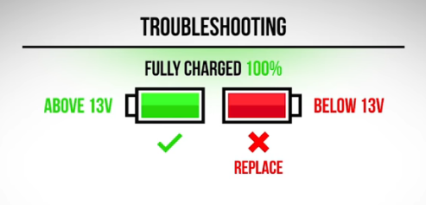


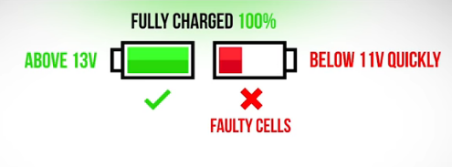


Testing and service
To test the battery package
Test each battery separately that disconnect from other batteries
Test voltage level equipment
MULTIMETER
VOLTMETER
WATTMETER
Vehicle driven in hot temperature shows faster decline in battery SoH
Higher battery life achieved by lowering load current
Minimize fast charging
BATTERY DEAD

